Slide 1
Mixed Integer Geometric Programming for Aircraft Configuration Optimization 18.337 Final Project
Christopher Courtin
Grad Student, Course 16
International Center for Air Transportation

Slide 2
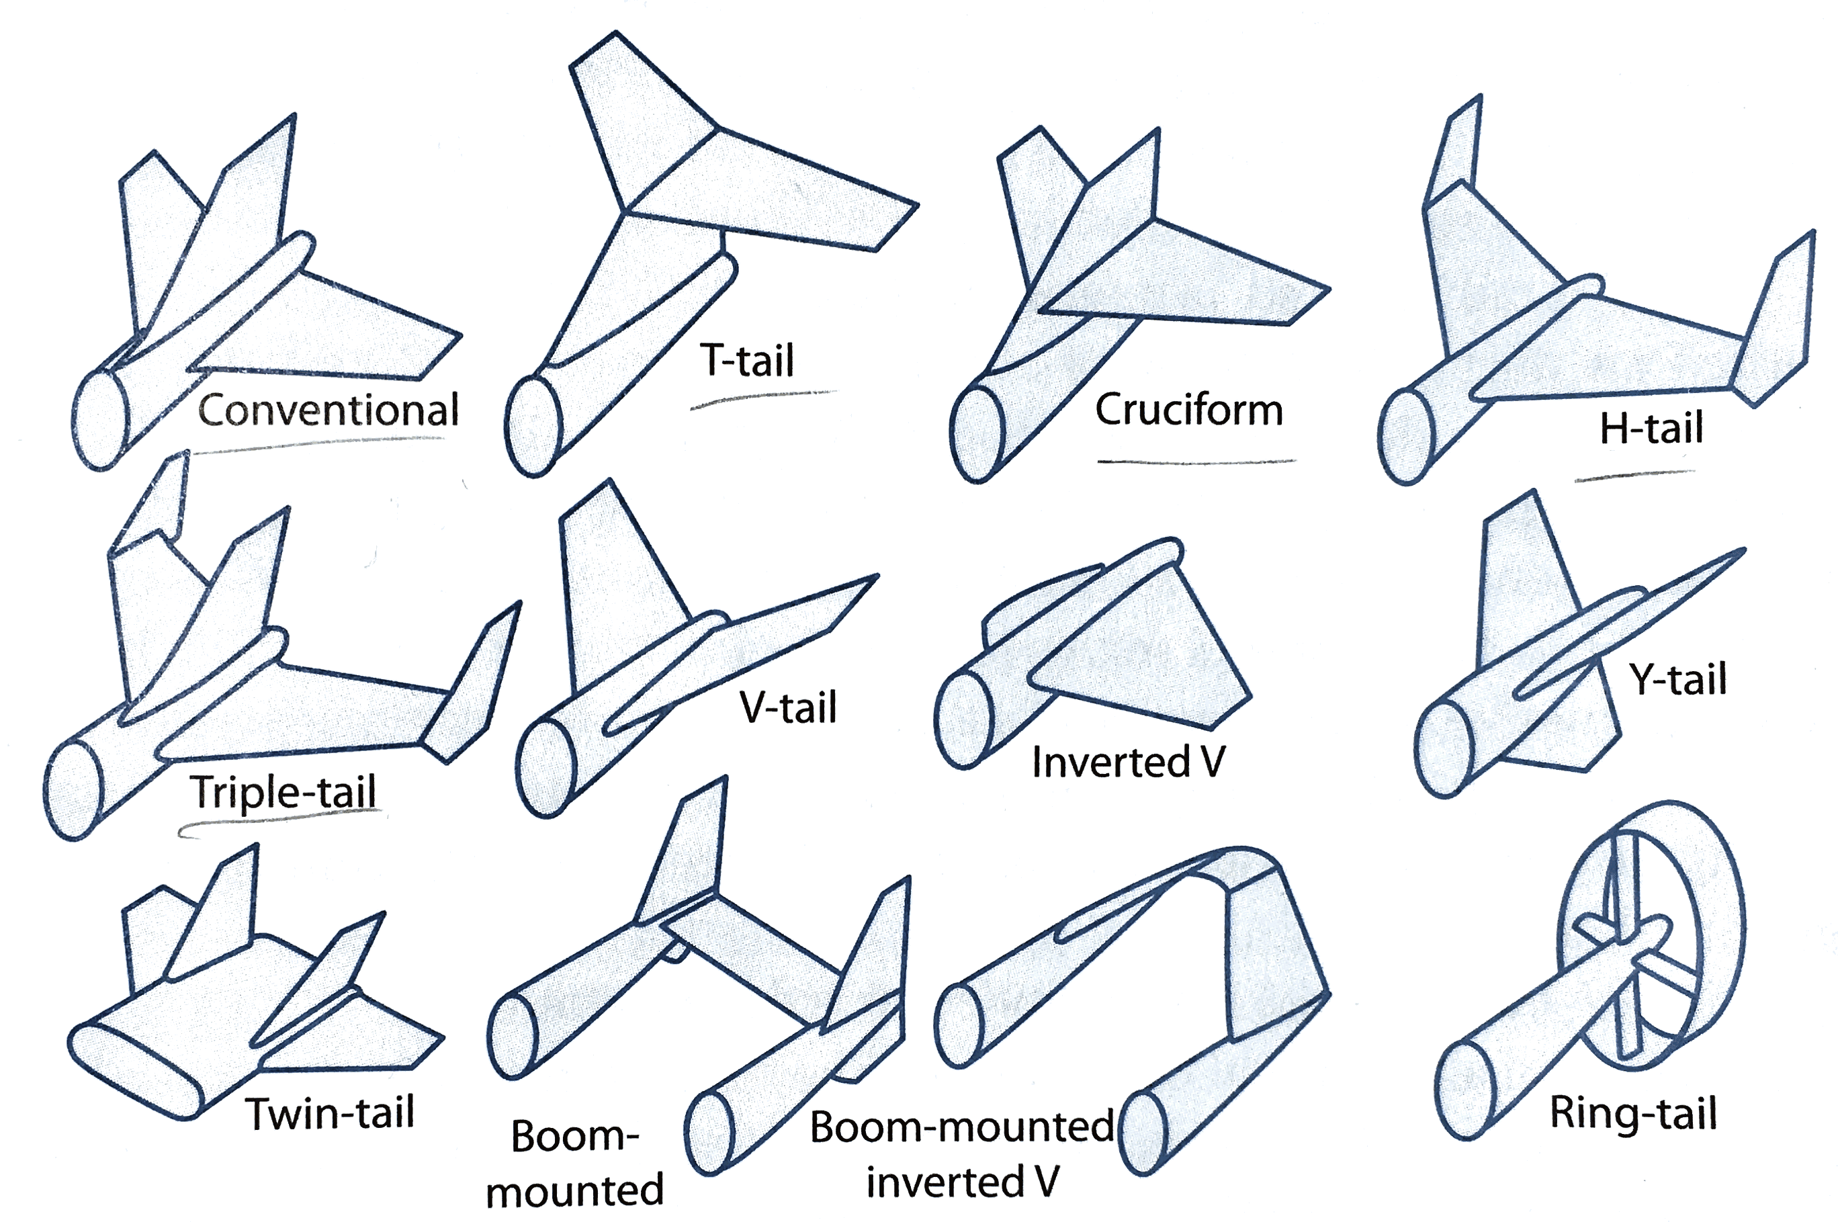
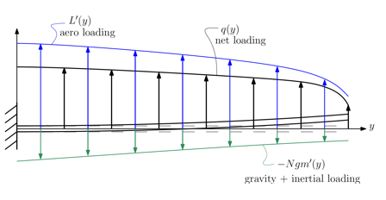
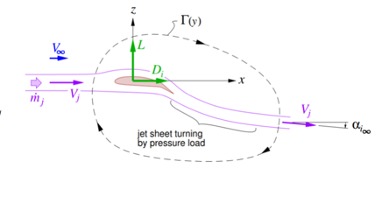
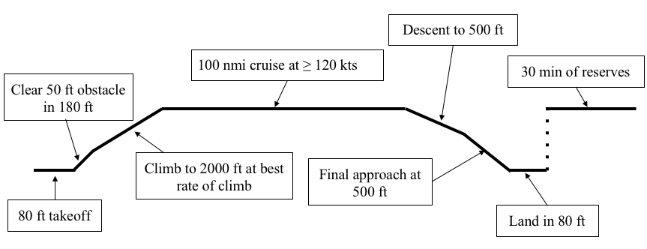
Aircraft Conceptual Design Overview
Design Concept
Compare/ evolve concept
Customers
Airline, Military,
UAV Operator,…
Designer
Increase modeling fidelity
Make better choices
Vehicle Sizing Process
Design Parameter
Range
Payload
Materials properties
…
Design Variables
Wing shape
T/W
Airfoils
…
Closed Vehicle Design
Weight
Energy requirement
Measure of “goodness”
Feedback to Customer
Design Feedback

Slide 3
Aircraft Conceptual Design Overview
Optimization techniques can help us here
Design Concept
Compare/ evolve concept
Customers
Airline, Military,
UAV Operator,…
Designer
Increase modeling fidelity
Make better choices
Vehicle Sizing Process
Design Parameter
Range
Payload
Materials properties
…
Design Variables
Wing shape
T/W
Airfoils
…
Closed Vehicle Design
Weight
Energy requirement
Measure of “goodness”
Feedback to Customer
Design Feedback

Slide 4
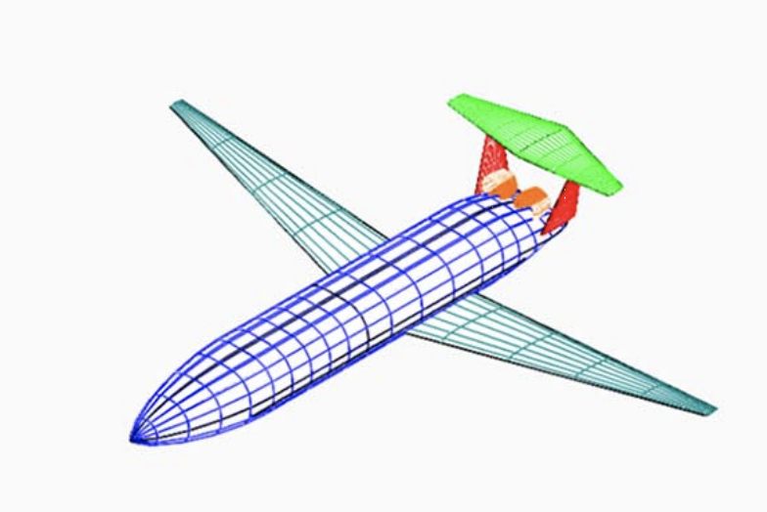
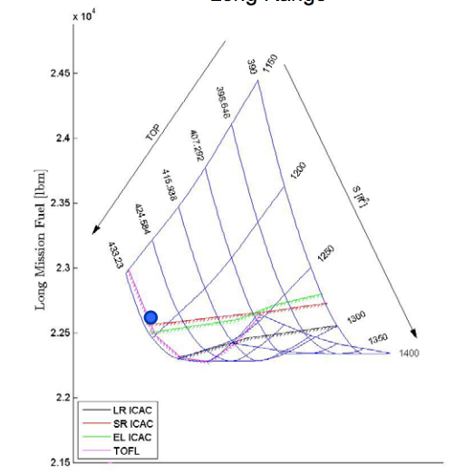
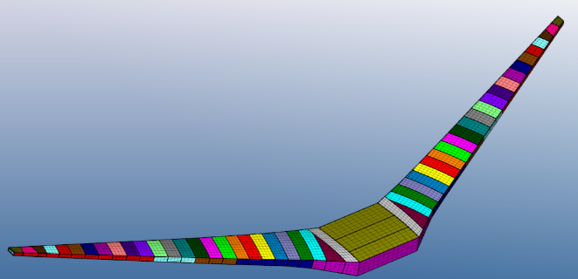
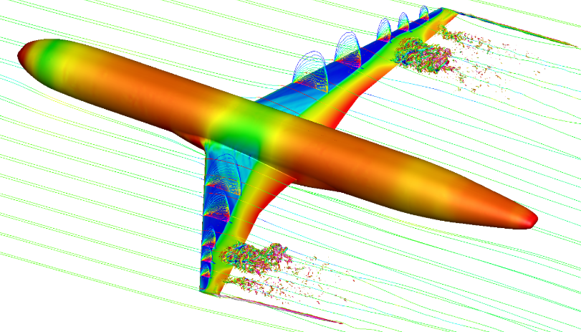
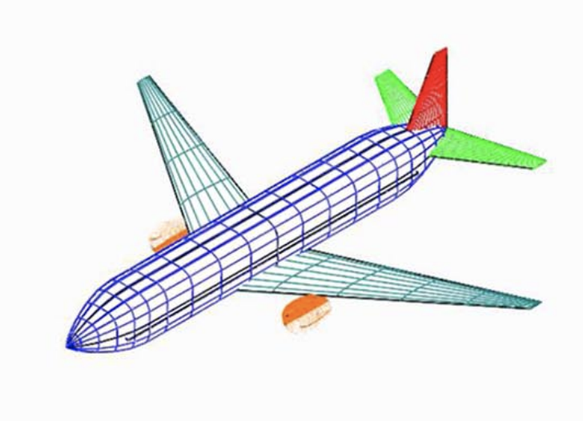
Aircraft Optimization Techniques
vs
Manual inspection
General MDO
Any models
Generally difficult optimization
Convex MDO
Only certain model types
Robust & fast optimization

Slide 5
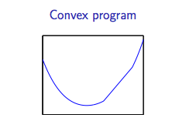
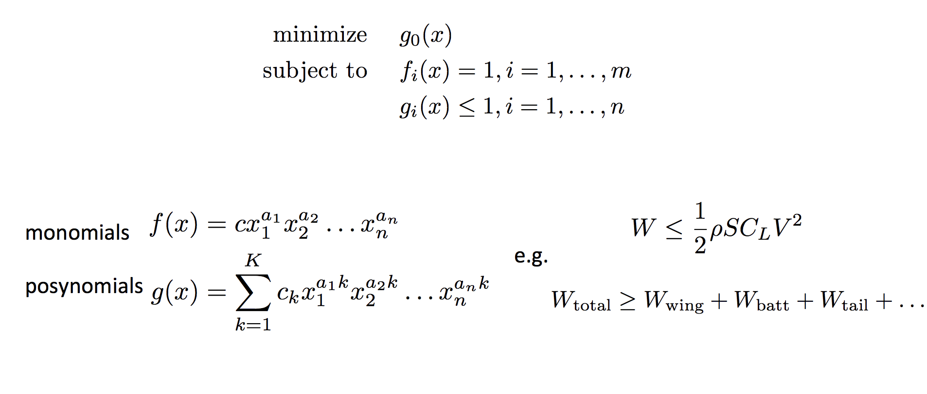
Geometric Programming
Formulate entire aircraft design problem as an optimization problem.
Convex under logarithmic change of variables
Fast and robust solvers available.
Decision variables must be continuous

Slide 6
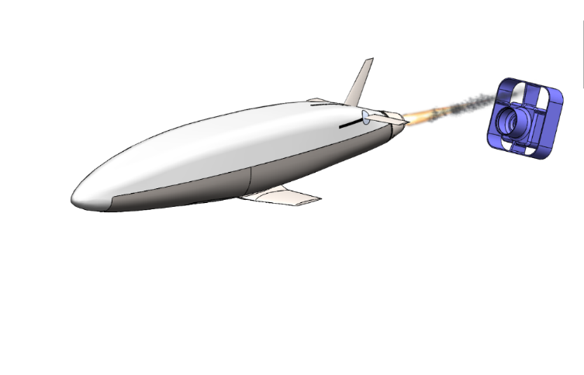
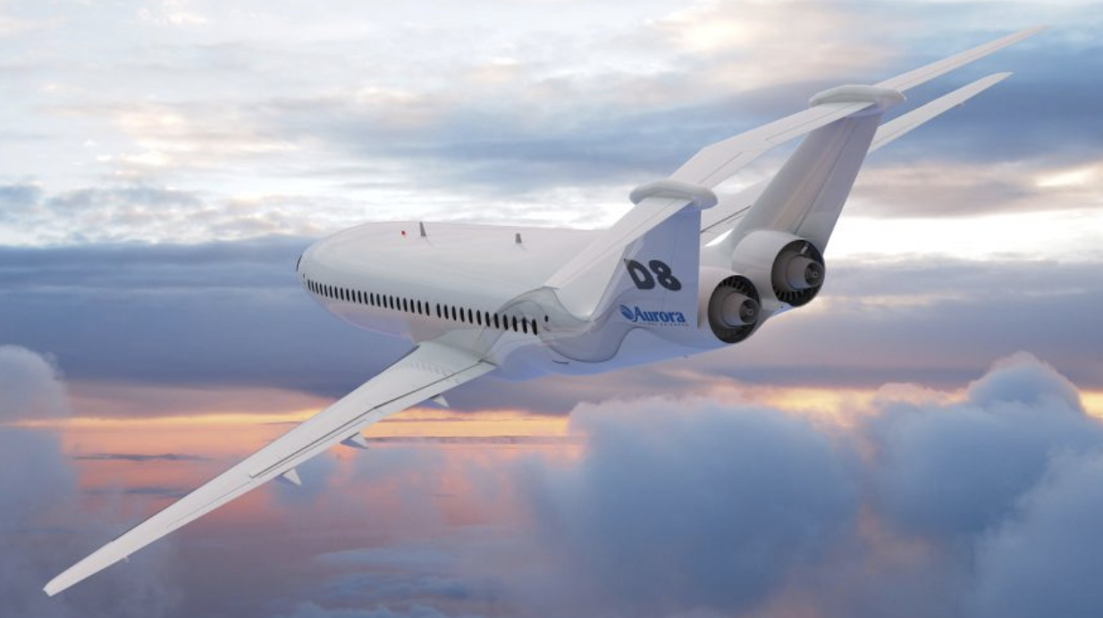
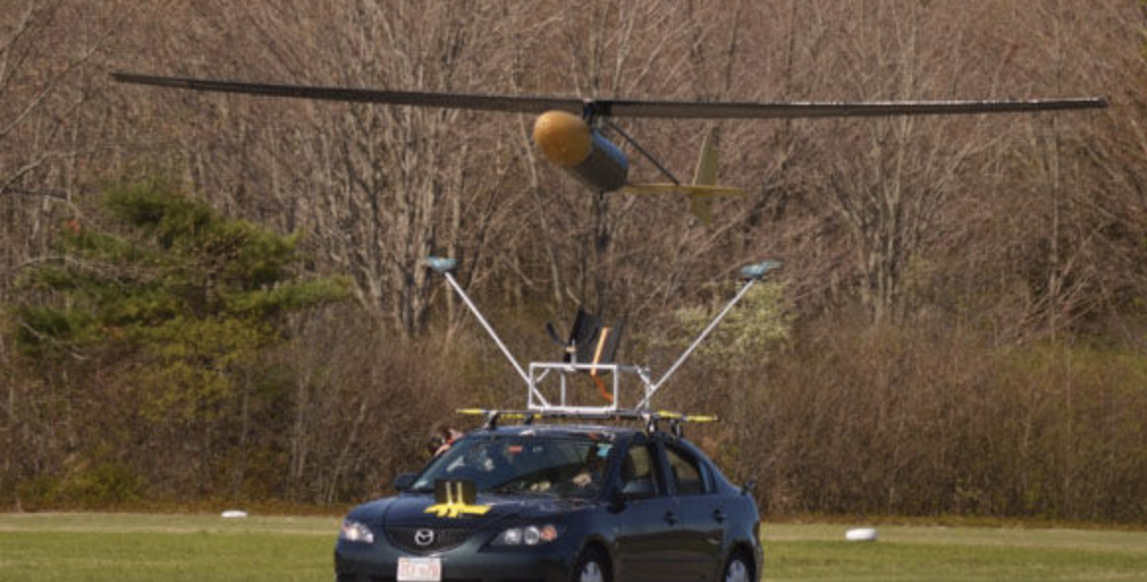
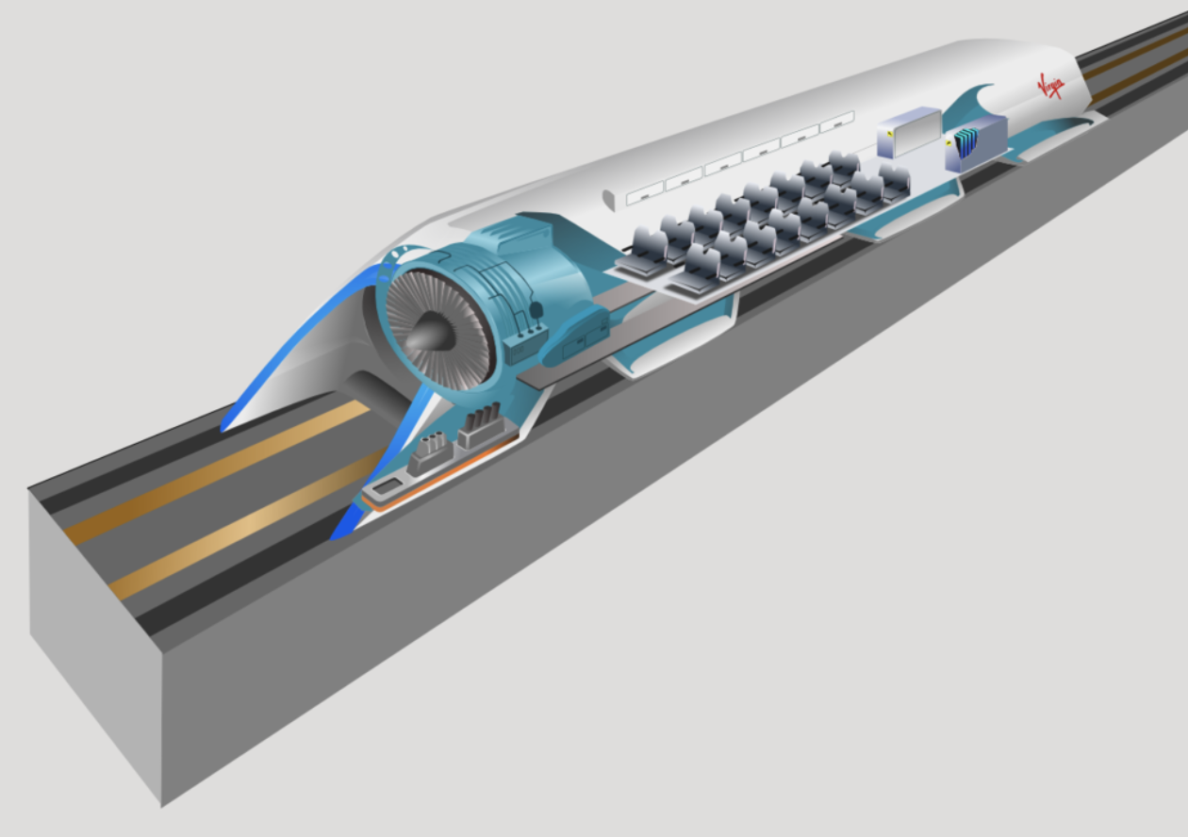

Geometric Programming is Useful
Rocket-powered UAV
D8 Advanced Subsonic Transport
JHO – 5 day endurance UAV
Ionic Wind Aircraft
Solar Powered Aircraft
eSTOL Aircraft
Hyperloop
and many more…

Slide 7
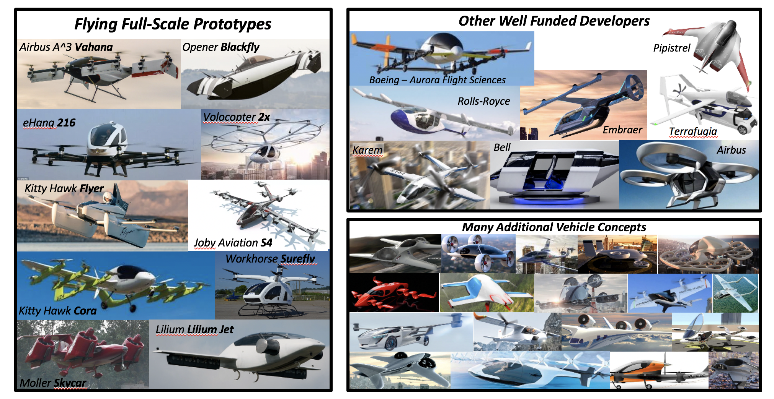
There is a lot of interest in electric aircraft
It’s not clear what the best configuration is for these aircraft

Slide 8
Aircraft Design Overview
Design Concept
Compare/ evolve concept
Customers
Airline, Military,
UAV Operator
Designer
Increase modeling fidelity
Can we include design concepts in our optimization framework?
Make better choices
Vehicle Sizing Process
Design Parameter
Range
Payload
Materials properties
…
Design Variables
Wing shape
T/W
Airfoils
…
Closed Vehicle Design
Weight
Energy requirement
Measure of “goodness”
Feedback to Customer

Slide 9

To optimize design concept, it is helpful to make discrete choices
Goal: Add integer variable capability to existing geometric programming framework
Existing framework
Python package to convert engineer-readable constraints to solver input
Commercial solver

Slide 10
Approach
Implement branch and bound algorithm in Julia to solve for integer variables.
Python package to convert engineer-readable constraints to solver input
Commercial solver

Slide 11
Demonstration Notebooks
Branch and bound visualization/comparison with JuMP
Electric aircraft demonstration problem/parallel speedup?
Julia Packages: LightGraphs, TikzGraphs, TikzPictures, PyCall, JuMP, Mosek, Distributed
Python Packages: gpkit, gpfit, gplibrary, mosek/cvxopt
References:
[1] W. W. Hoburg, “Aircraft Design Optimization as a Geometric Program,” 2013. https://convex.mit.edu/publications/hoburg_phd_thesis.pdf
[2] B. Borchers and J. E. Mitchell, “An improved branch and bound algorithm for mixed integer nonlinear programs,” Comput. Oper. Res., vol. 21, no. 4, pp. 359–367, Apr. 1994.
https://www.sciencedirect.com/science/article/pii/0305054894900248
[3] S. Leyffer, “Integrating SQP and Branch-and-Bound for Mixed Integer Nonlinear Programming,” 2001.
https://link.springer.com/content/pdf/10.1023%2FA%3A1011241421041.pdf

